Slide 1
MINI PROJECT
Name | Sneha V Shet Anushree S G Sufiya Taranum
Registration Numbers | 241058017 | 241058028 | 241058038
Branch | Big Data Analytics
Project Title | Streamlining Object Detection using TensorFlow for Plant Disease classification.
Guide | Dr. Prathviraj N

Slide 2
CONTENTS
Introduction
Literature Review
Objective
Operational Flow
Functional Requirements
Implementation
Work Done
Results
Conclusion
Future Work
References

Slide 3
INTRODUCTION
Farmers face economic losses every year because of various diseases that can happen to fruit/vegetable growing plants. If farmer can detect these diseases early and apply appropriate treatment then it can save lot of waste and prevent the economic loss.
Object detection is a fundamental task in the field of computer vision, involves identifying and classifying objects within images or videos. From autonomous vehicles to medical imaging, object detection plays a crucial role in various industries.
In modern machine learning projects, the complexity of managing data, experiments, and model deployment grows significantly.
Traditional approaches often struggle with challenges such as handling large datasets, optimizing model training, and tracking experiments in a reproducible manner.
This project aims to address these challenges by leveraging one powerful tool: Tensorflow.

Slide 4
Tensorflow simplifies the management of data science workflows, allowing teams to build and iterate on models more efficiently.
Google provides the cloud infrastructure necessary to scale object detection models, ensuring that training and inference can be performed on large datasets with high computational demands.
By integrating these technologies, the project offers a streamlined, end-to-end solution for object detection.
This approach can be done in cloud platforms to improves collaboration, scalability, and experiment management, resulting in faster development cycles and more reliable deployments in real-world applications.

Slide 5
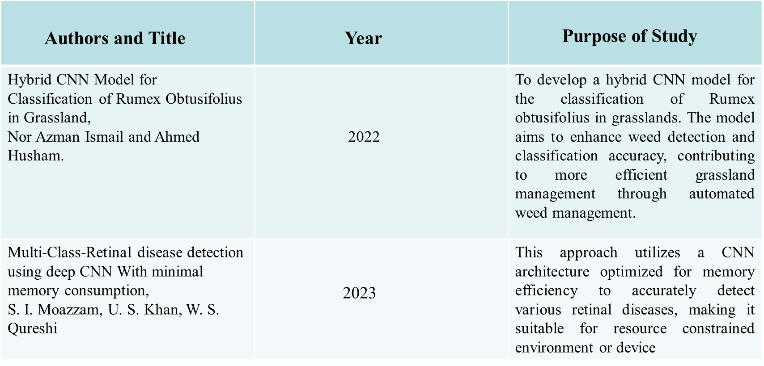
LITERATURE REVIEW

Slide 6
OBJECTIVE
The integration of Tensorflow, Keras and cloud in object detection projects is used to:
Detect the plant classification effectively, to Enhance classification accuracy, enhancing the capability of feature extraction and representation.
Enhance efficiency and automation through streamlined workflows and scalable resources.
Improved Feature Extraction: To overcome the limitations of conventional machine learning models by leveraging a Convolutional Neural Network (CNN) model that automatically extracts relevant features from plant images for precise disease classification.
Accurate Disease Identification: To accurately classify different types of diseases affecting plants, such as distinguishing between early blight and late blight in potato plants, enabling targeted treatment

Slide 7
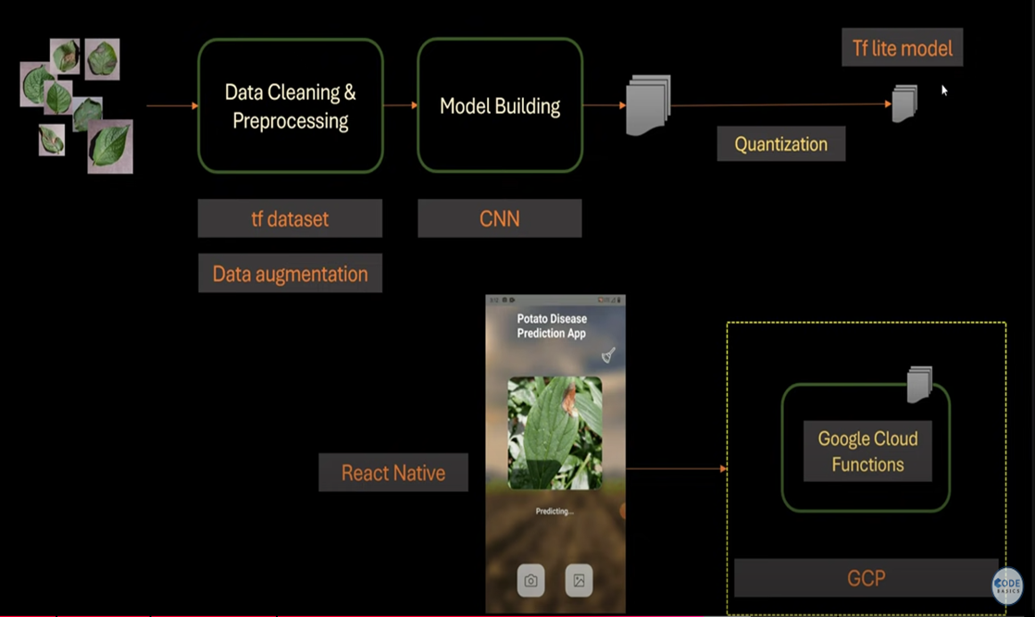
OPERATIONAL FLOW
Fig 1: Overview of project flow

Slide 8
FUNCTIONAL REQUIREMENTS
Software Requirements
OS: Windows
Python: Version 3.7+
Libraries: TensorFlow 2.x, Keras, NumPy, Matplotlib, TensorFlow Lite
Cloud Platforms: GCP
Functional Requirements
1.Model Selection and customization
2.Input Data Handling
3.Training Framework
4.Model Evaluation and Interface optimization
5.Deployment

Slide 9
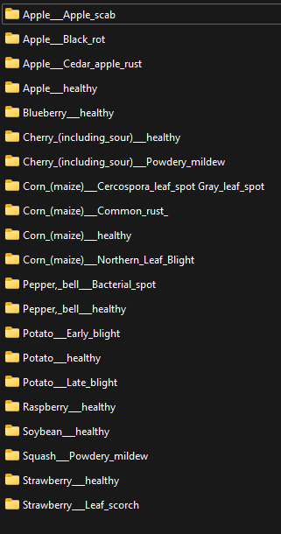
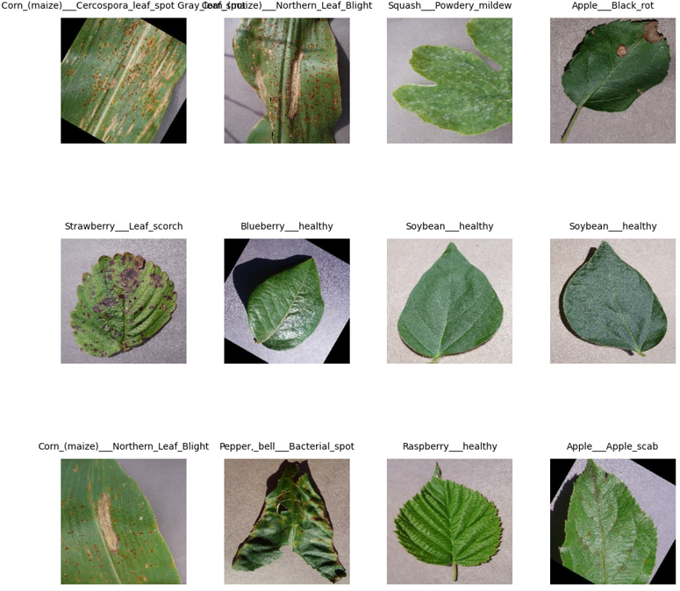
IMPLEMENTATION
Plant Dataset –
39152 images with 21 different types of classes of plants.
Training Data –
80% of Total data will be 31,319 images for training.
Testing Data –
20% of total data will be 7,833 images for validation.
Fig 2 :Visualizing the first 12 images of different classes using MatPlotLib

Slide 10
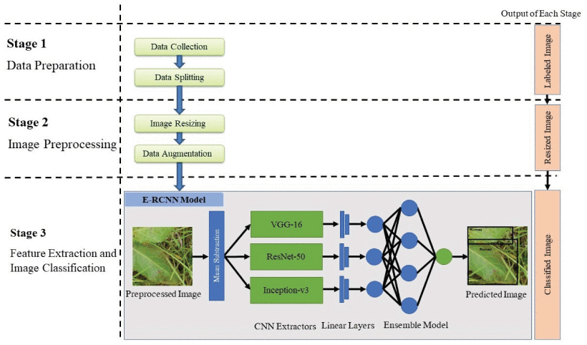
IMPLEMENTATION
Data Collection
Data Splitting
Image Resizing
Data Augmentation
CNN
Layers
Predicted class
Fig 3: Image Classification with Tensorflow

Slide 11
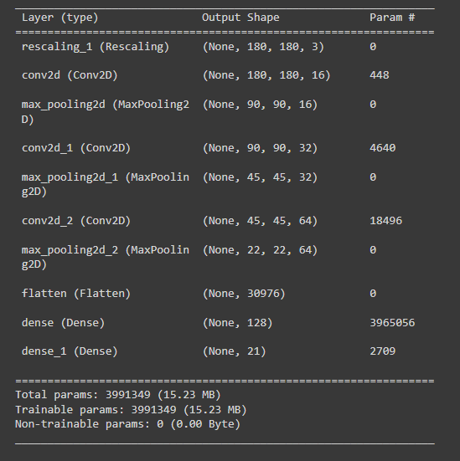
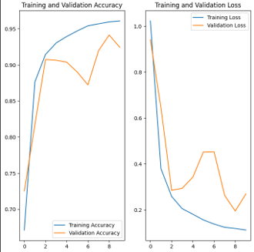
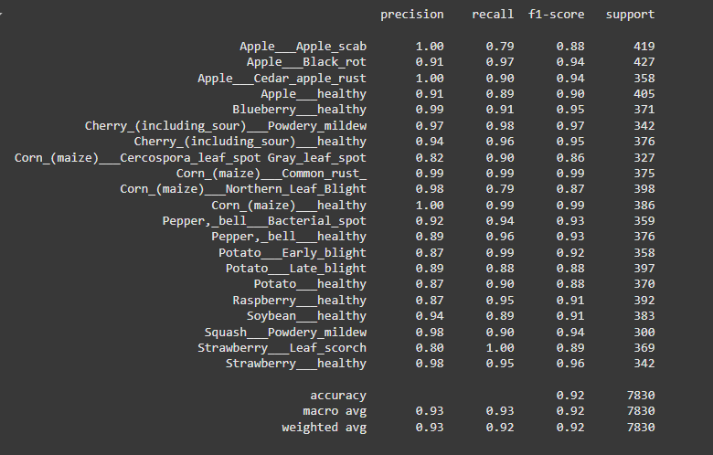
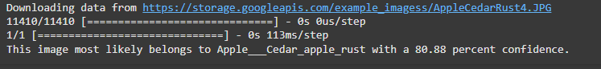
WORK DONE
1.CNN Model
Classification report
Training Accuracy 92%
Testing Accuracy : 80%

Slide 12
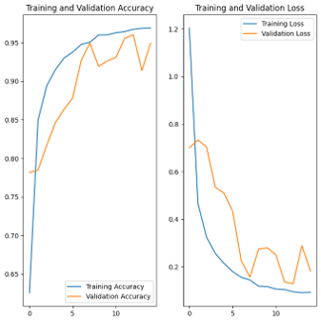
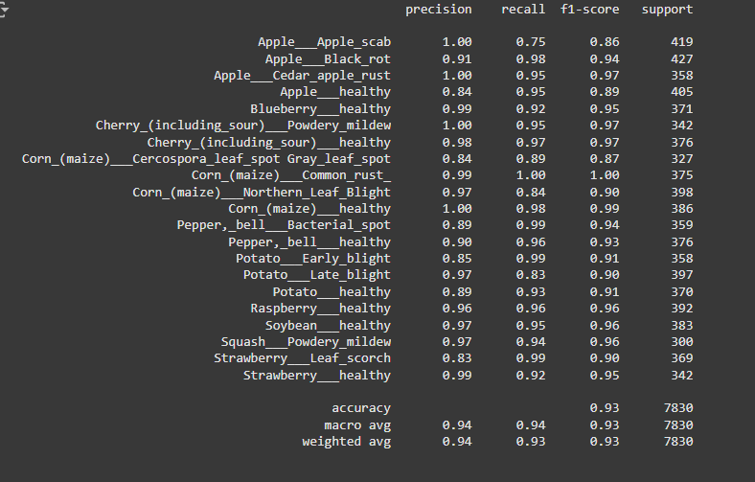
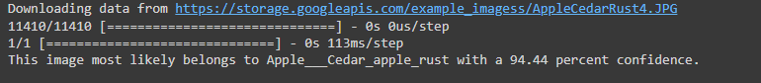
WORK DONE
1.CNN Model After Hyperparameter tuning
Classification report
Training Accuracy 93%
Testing Accuracy : 94%

Slide 13
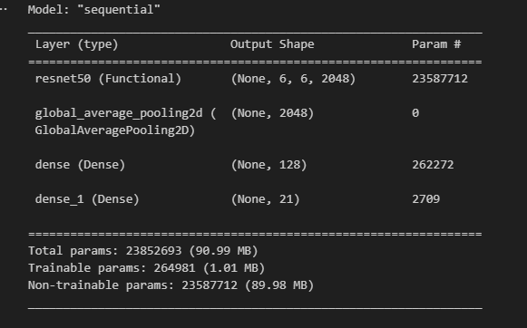
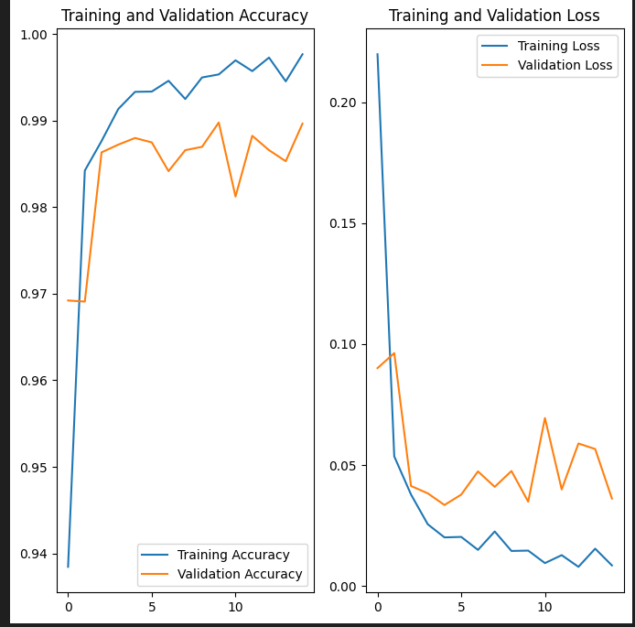
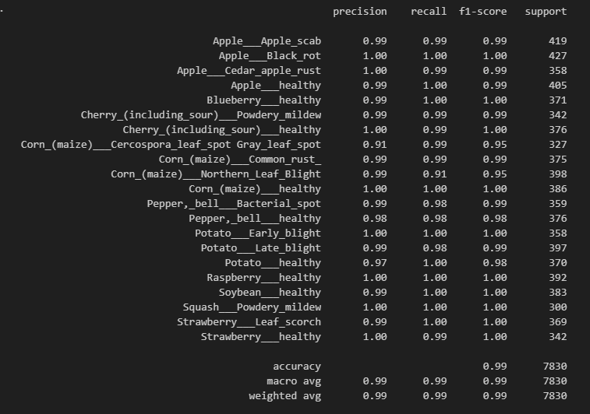
WORK DONE
3.ResNet50 model
Classification report
Training Accuracy 99%
Testing Accuracy : 80%

Slide 14
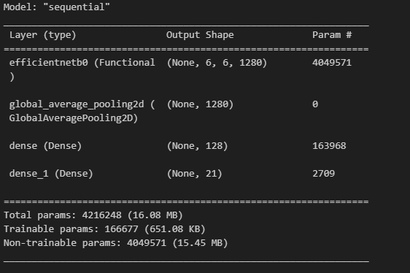
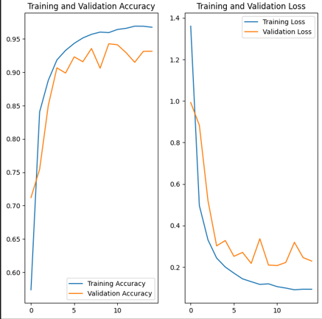
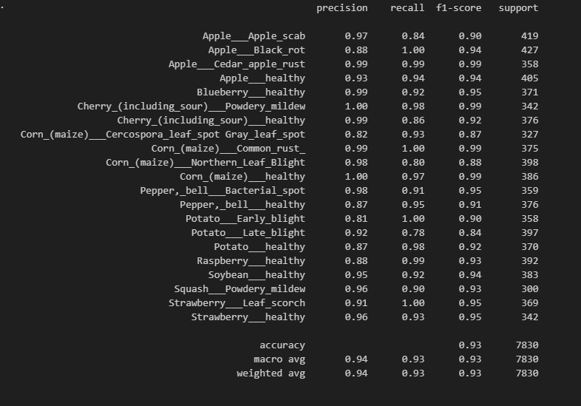
WORK DONE
4.EfficientNet model
Classification report
Training Accuracy 93%
Testing Accuracy : 92%

Slide 15
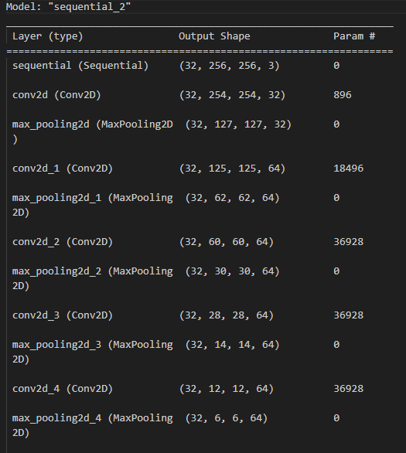
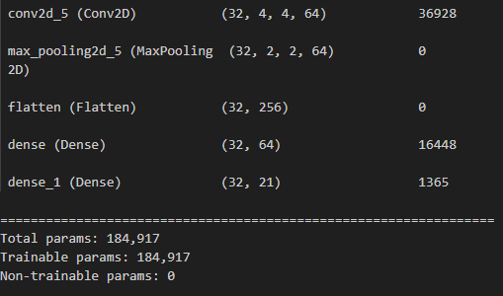
WORK DONE
5. CNN model with extra layers.

Slide 16
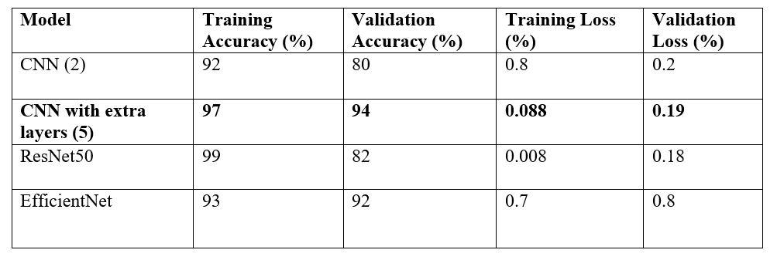
CONCLUSION

Slide 17
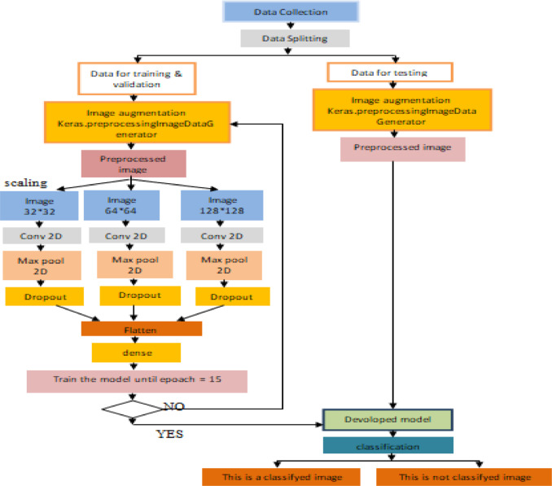
CNN Model
Desired Output

Slide 18
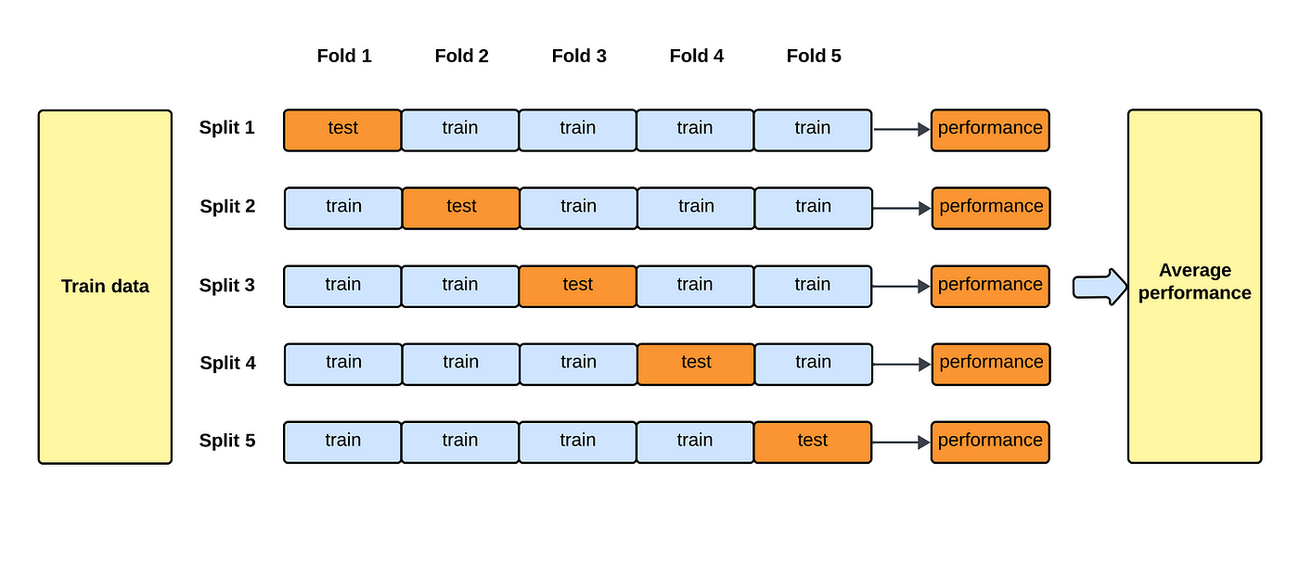
K Fold Validation for CNN Model
91%
93%
Average Accuracy – 91.9%
Standard Deviation – 0.0209
88%
92%

Slide 19
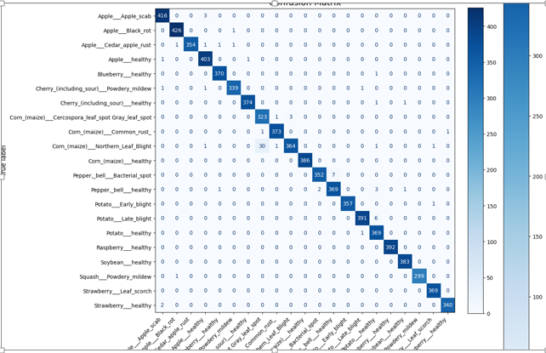
Fig 6: Confusion matrix

Slide 20
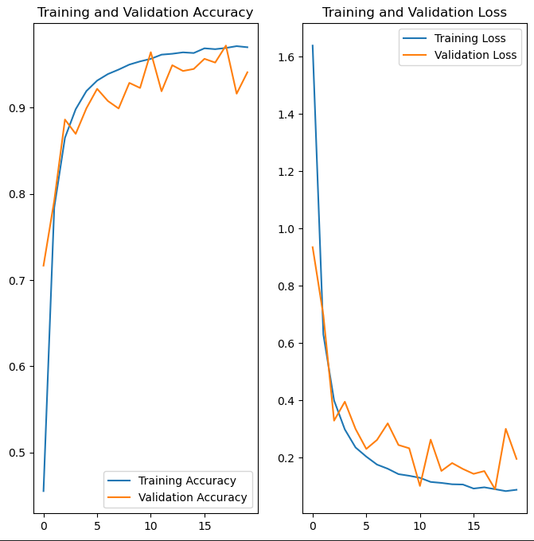
RESULTS
Training and Validation Accuracy
Training Accuracy increases quickly and levels off near 97%, showing the model is learning well from the training data.
Validation Accuracy follows a similar trend, suggesting the model generalizes well and isn't overfitting showing with accuracy of 94%.
Training and Validation Loss
Training Loss decreases sharply, indicating improved model predictions on the training data.
Validation Loss also decreases, with some fluctuations, showing the model generalizes well without major divergence from the training loss.
Fig 5 : Training and Validation Accuracy and Loss after Data Augmentation(Good Fit )

Slide 21
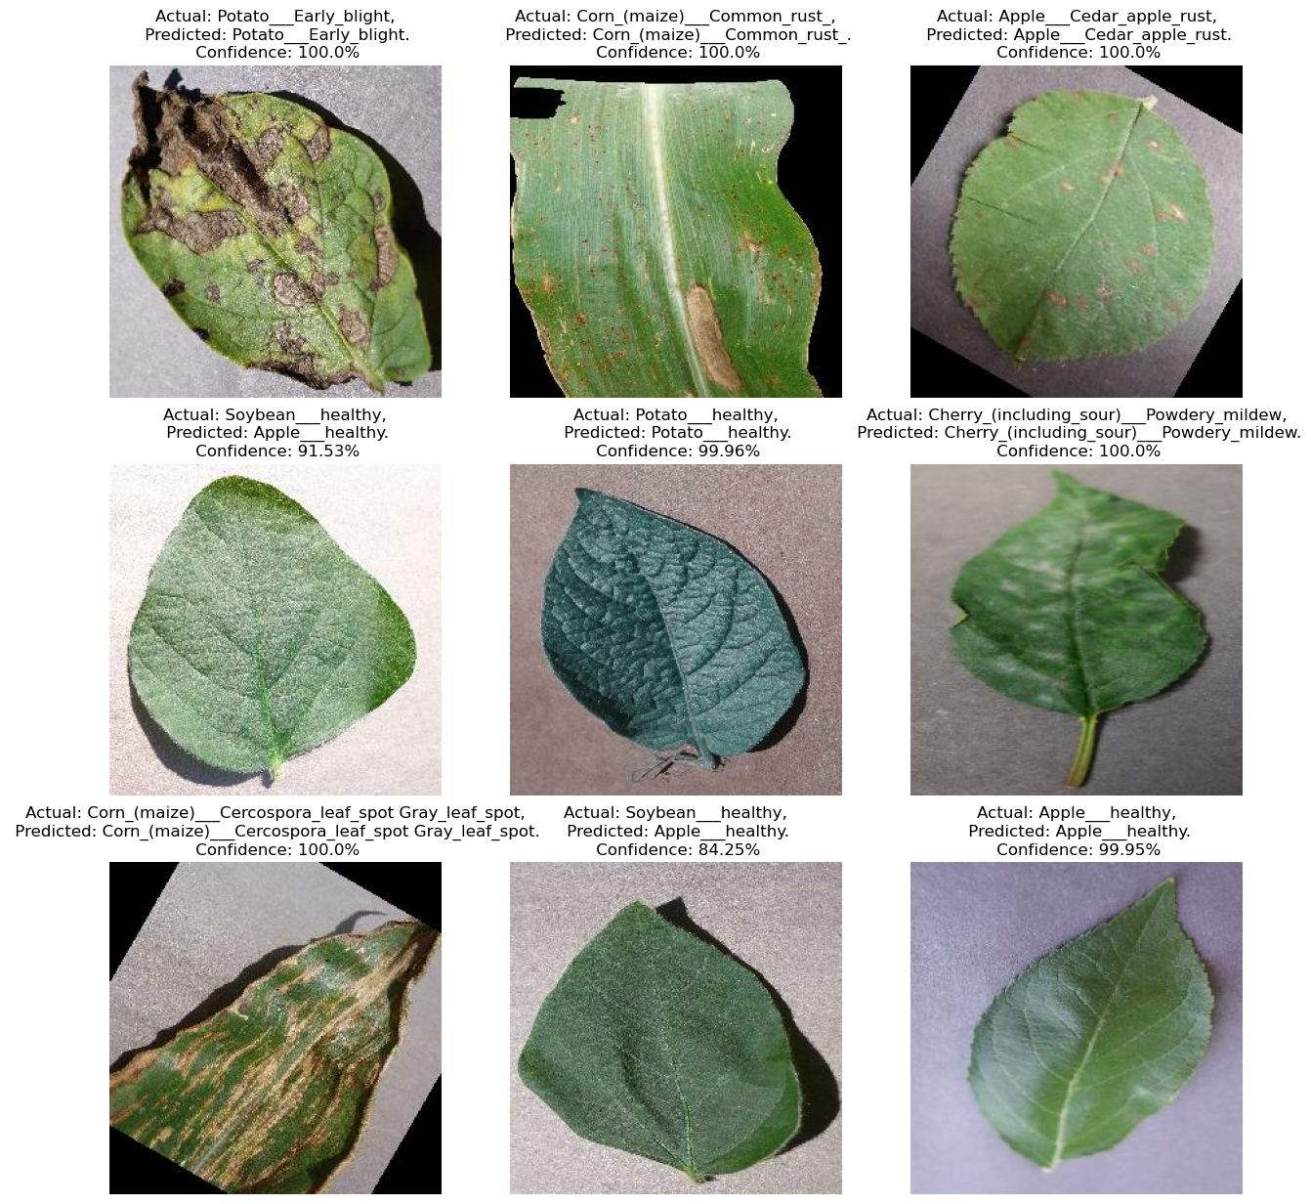
RESULTS
Predict on New Data:
Using model to classify an image in the training or validation sets.

Slide 22
FUTURE WORK
-Deploy in cloud platforms for smooth operations.
-Creating UI where farmer can upload image directly and get to know about the disease and treatment plan.

Slide 23
REFERENCES
[1] C. Huyen, Introduction to Machine Learning Interviews (2021), Self-published
[2] V. Tuulos, Effective Data Science Infrastructure (2022), Manning Publications Co.
https://towardsdatascience.com/streamlining-object-detection-with-metaflow-aws-and-weights-biases-b44a14cb2e11
https://github.com/EdIzaguirre/plant-object-detection
https://www.tensorflow.org/tutorials/images/classification

Slide 24
THANK YOU

